Slide 1

Design To Runtime Using Event Portal and SEMP APIs

Slide 2
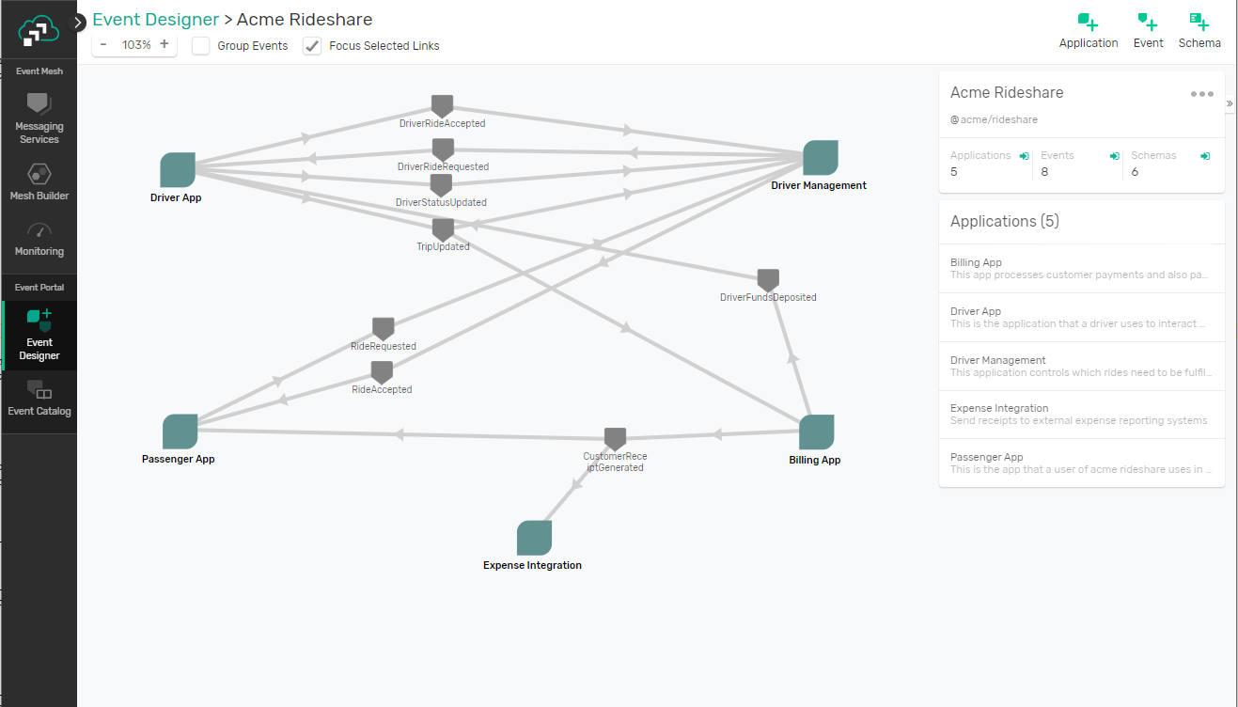
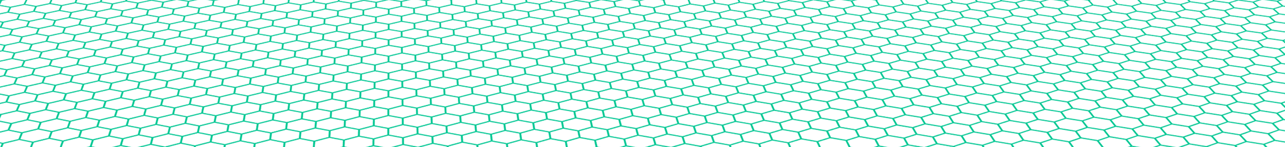
Introducing PubSub+ Event Portal
Single place to design, create, catalog, visualize, discover, share, secure and manage all events within your ecosystem
PubSub+ Event Portal
Event Brokers
Mainframe/SAP
Distributed Apps
Server Less
Micro services
IoT
Notes:
So today we’re excited to introduce to you an event management product – first of its kind PubSub+ Event Portal.
Think of it as a single place to design, create, visualize, discover, share, secure and manage all events within your ecosystem.

Slide 3
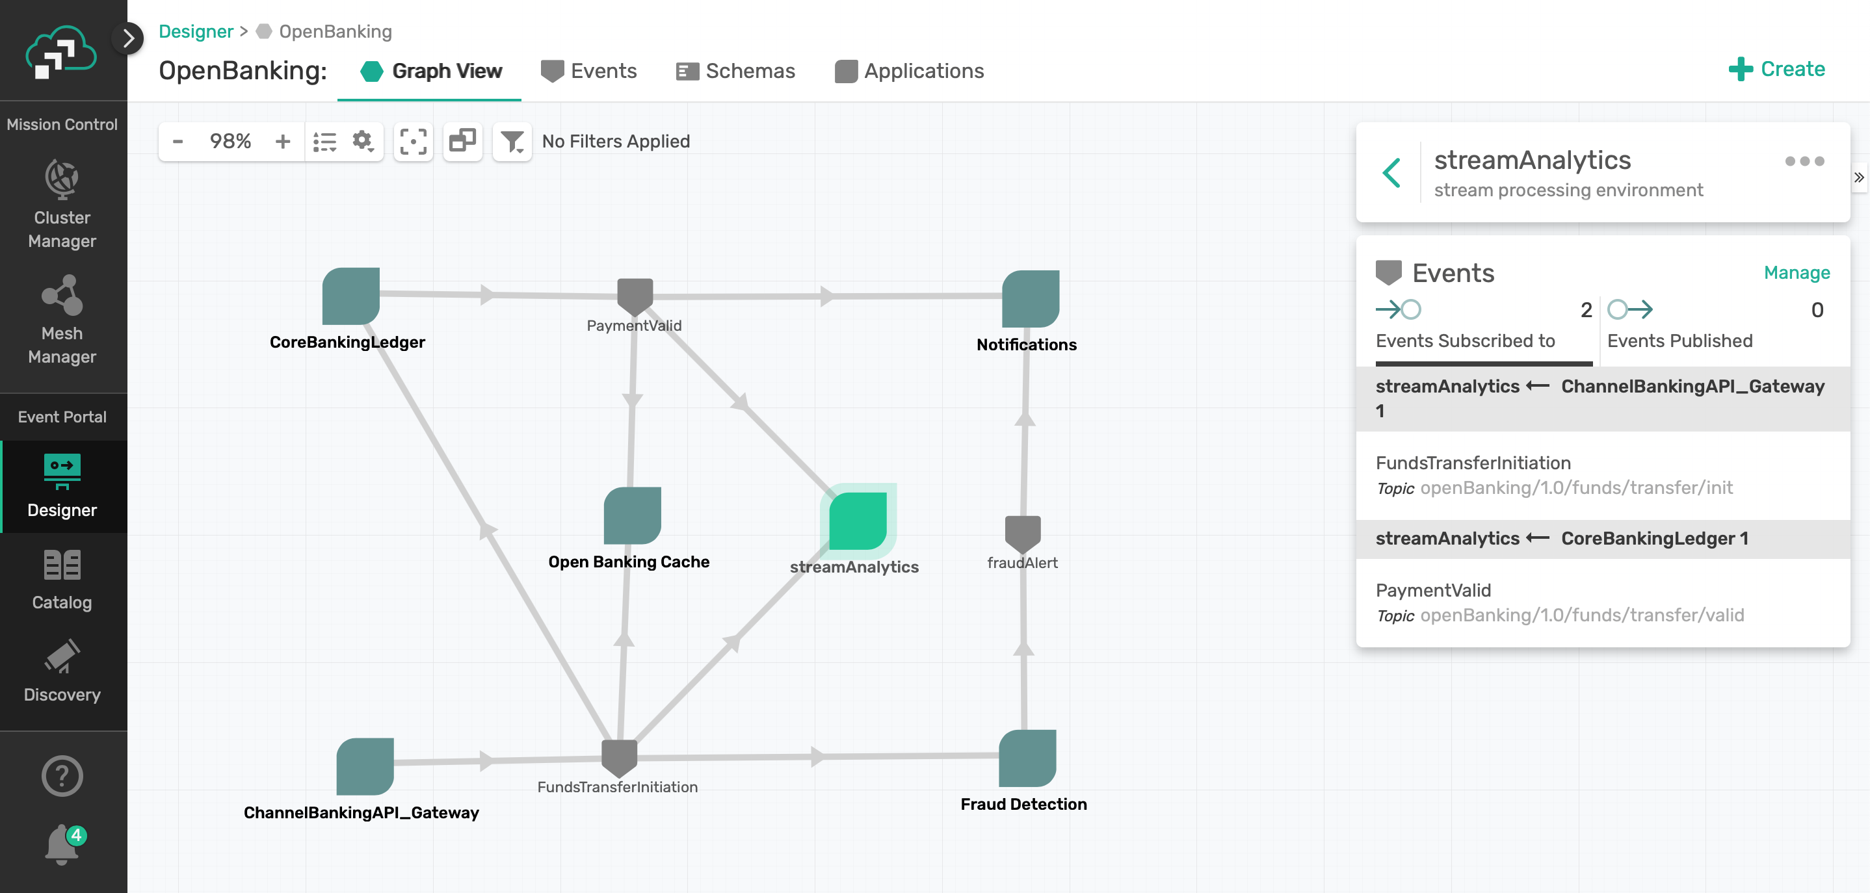
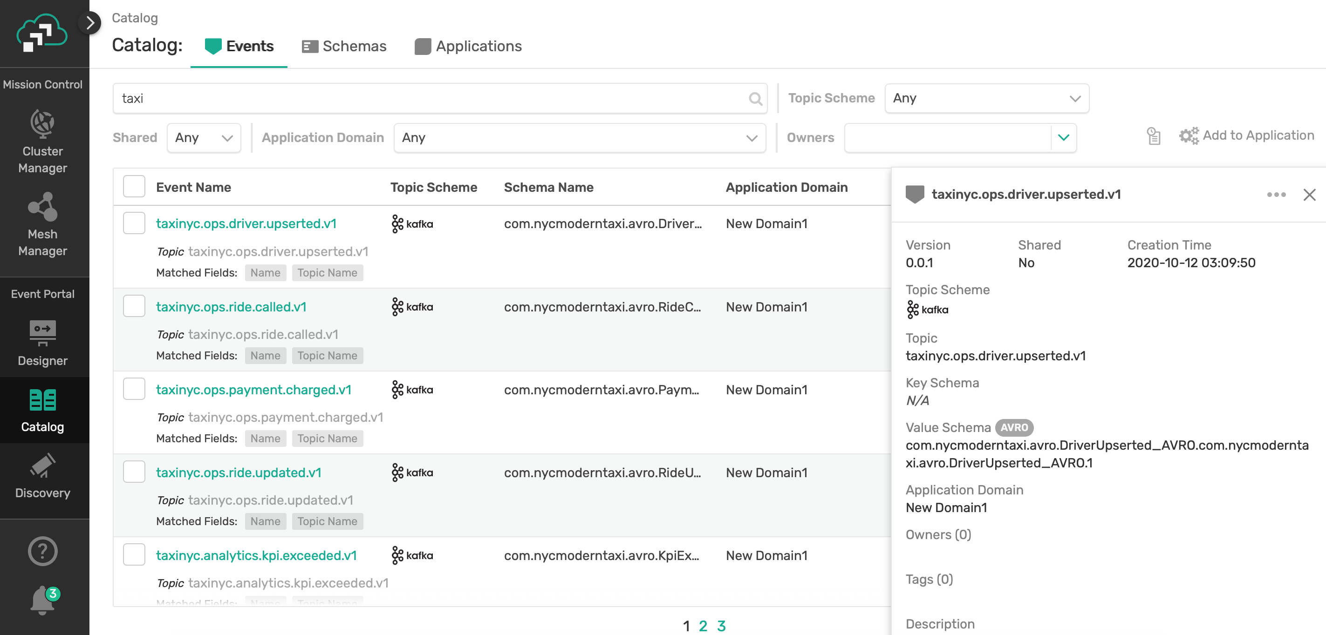
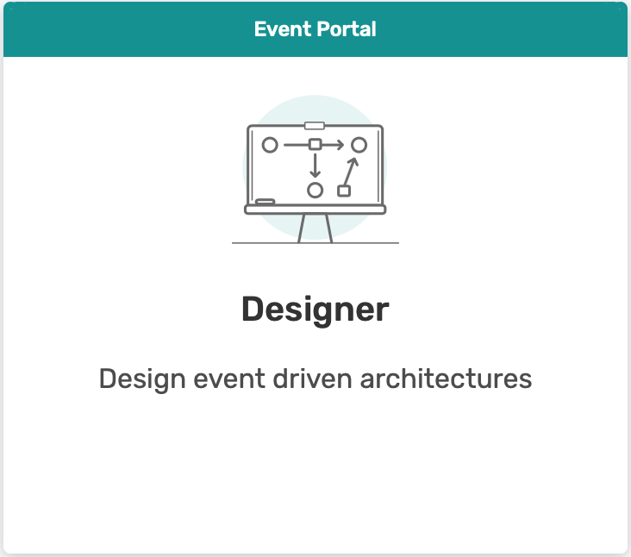
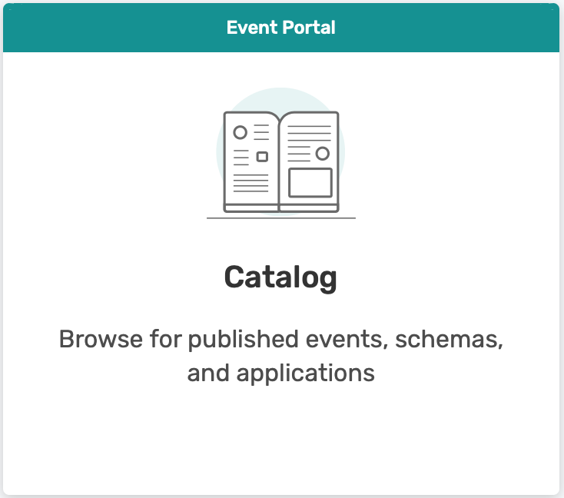
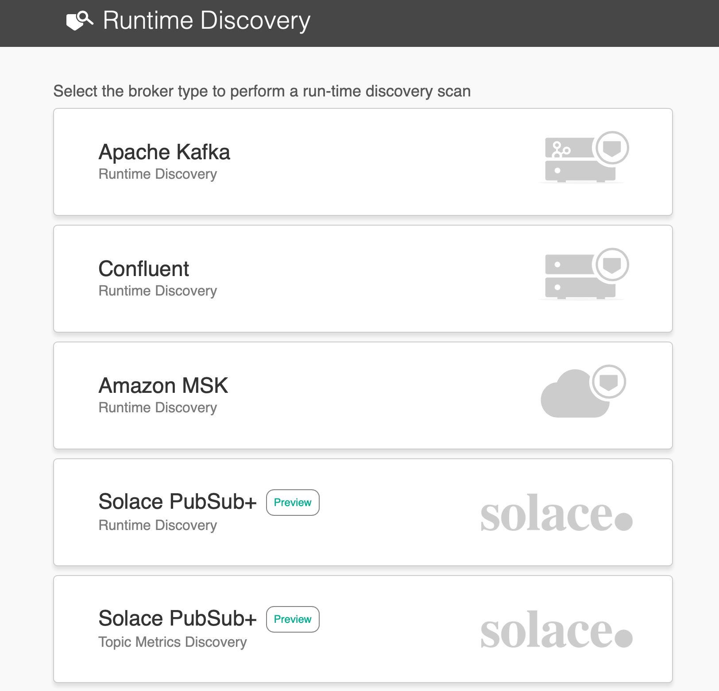
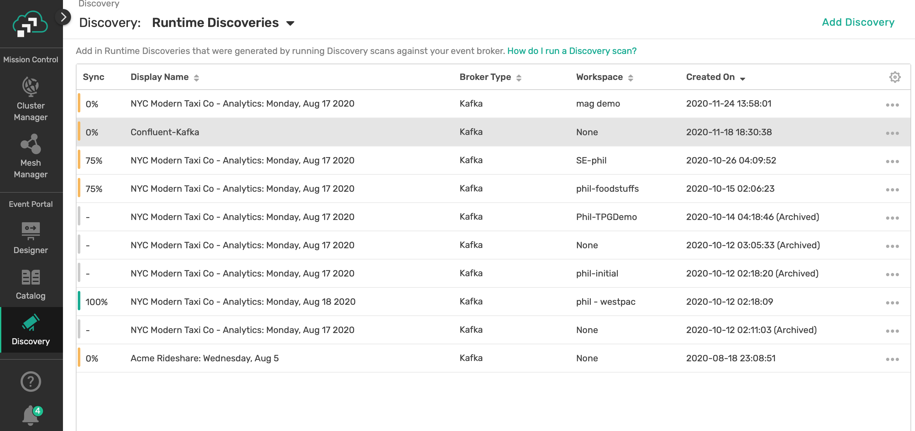
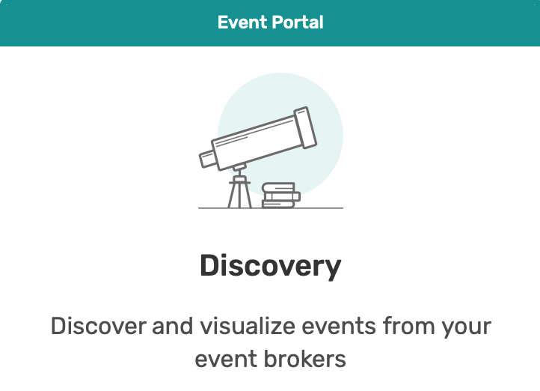
PubSub+ Event Portal
Design Time
Event Portal
Designer & Catalog
Runtime
Event Portal
Runtime
Discovery
Audit
Metrics*
Notes:
Everyone is familiar with runtime….where you have Event brokers – for example Kafka, Solace, IBM MQ, Rabbit, Active, etc that provide the security policy enforcement, persistence, one to many distribution for your company… but how do you manage and design all these event streams. We used the API management model to create a product that you could use to design, develop and manage event-driven apps…discover events, govern,,build a community of developers and architects and generate code using AsyncAPI. This Event Portal can then connect with Event Brokers in runtime regardless of what type of brokers they are.

Slide 4
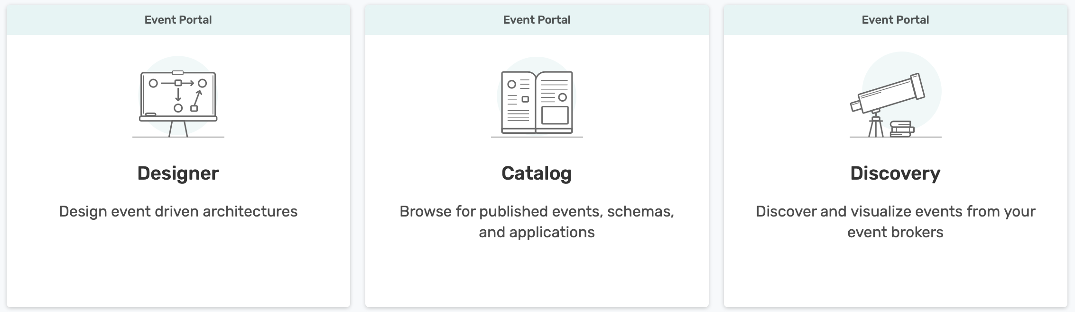

How Users Interact with Event Portal
Architects
Discover, create, update, review apps, events and payload schemas
Map payload schemas to events; and events to apps
Govern event consumption across app domain boundaries
Developers
Collaborate with architects on design
Export AsyncAPI app contracts for each app
Generate and implement event-driven apps that provide business value
Data Scientists
Understand event-driven data
Discover new insights by combining events
B2B/B2C Ecosystem
Your Event Driven Enterprise
Event Management
(Design Time)
Existing Tools
Schema registries
Data lineage
CI/CD pipelines
PubSub+ Event Portal
Customers & Partners
Discover and consume events in real-time
REST API
Generate Code
Server- less
Micro- services
IoT
Notes:
The PubSub+ Event Portal was built for architects, developers and data scientists to use.
Imagine this single source of truth – of all your events, apps, schemas from various sources including schema registries, data lineage tools , interfacing with CI/CD pipelines
Architects: discover, create, update, review apps, events and payload schemas; they can map payload schemas to events and events to apps; govern event consumption across app domain boundaries
Developers can now collaborate with architect on design, export AsyncAPI app contracts for each app and generate/implement event-driven apps that provide value to the business
And data scientists can understand the event-driven data and combine events and discover new insights
This is how you can expedite your journey to become real-time and respond to customers and partners when you need to .

Slide 5
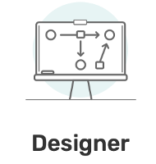
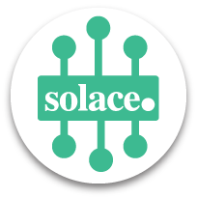

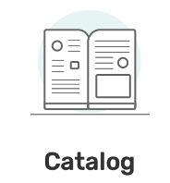
Several ways to get started in designing your event flows
From Runtime to Designer and catalog
For existing Solace/Kafka users
From Designer to Runtime
For new Solace/Kafka users
For existing users as well
1
Live discovery
of events being processed
2
3
Scan file
Repository of your events flows
Scan file import
Runtime
1
Design your event flows in Designer and Catalog
2
Today’s demo !
Commit to runtime
Runtime

Slide 6
Demo overview: from Designer to Runtime
Design Time
1
Use Designer
to draw your event flows
2
Staging area
Artefact selection
3
Commit to runtime
Runtime
Queues and subscription created

Slide 7
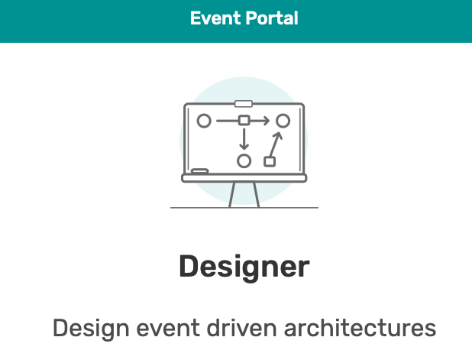
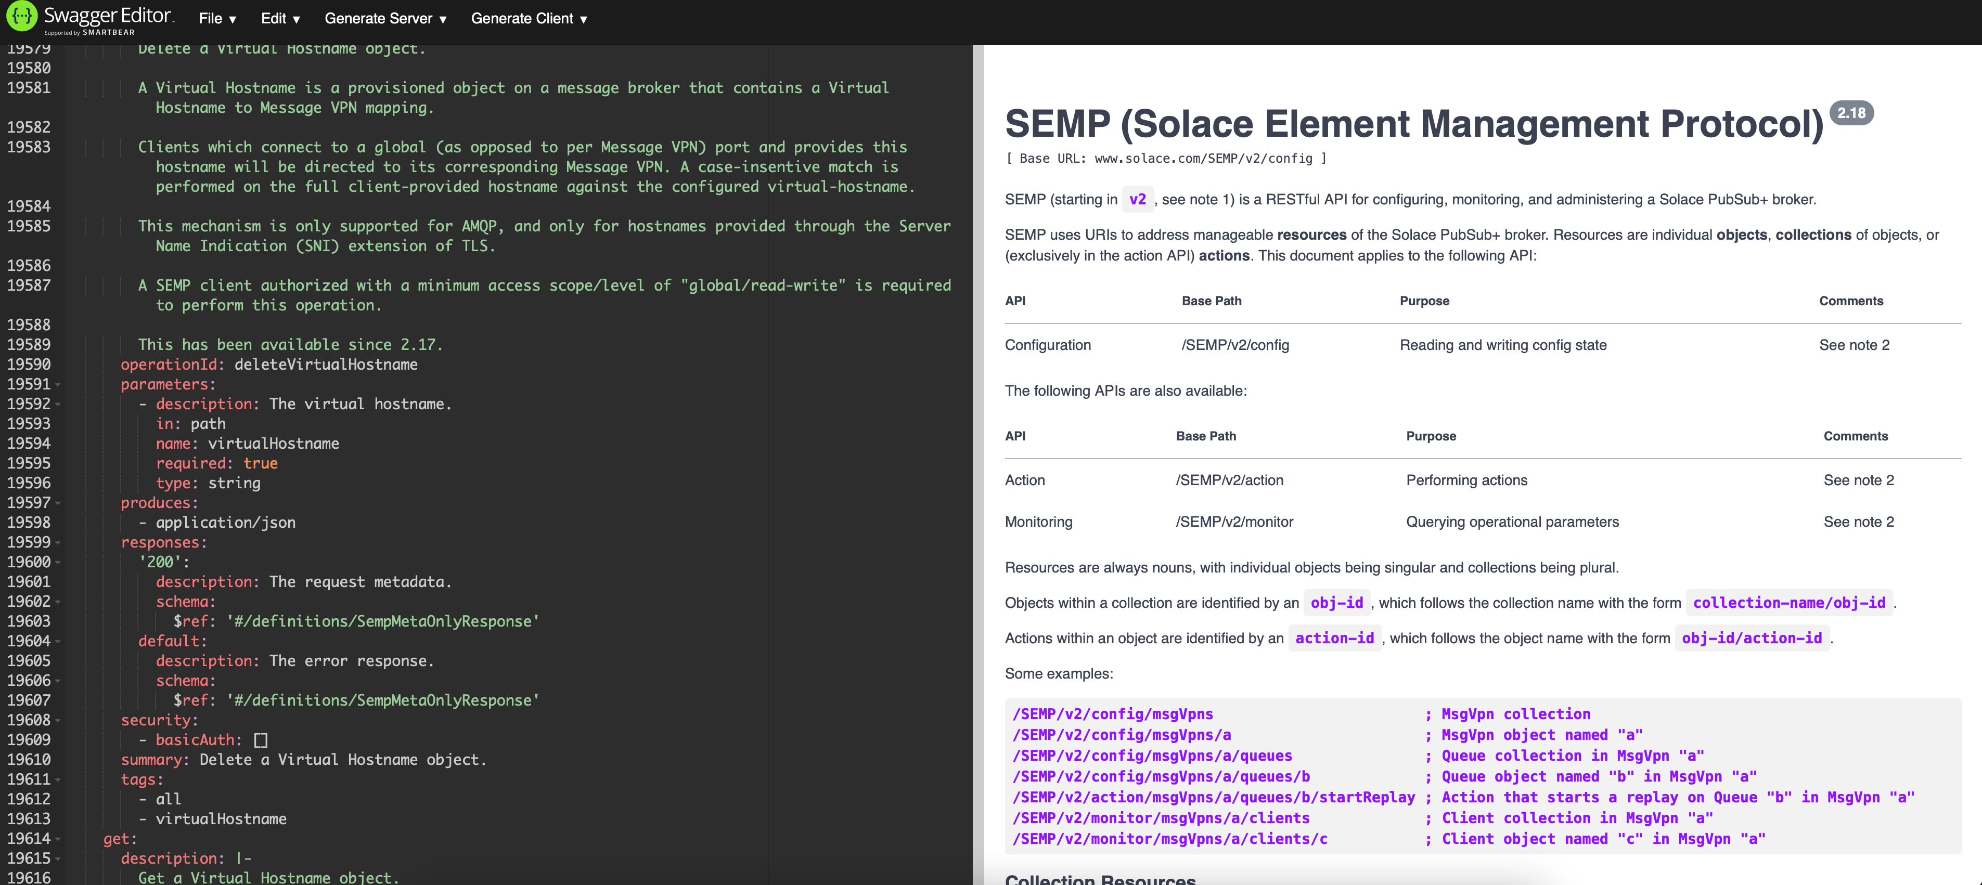
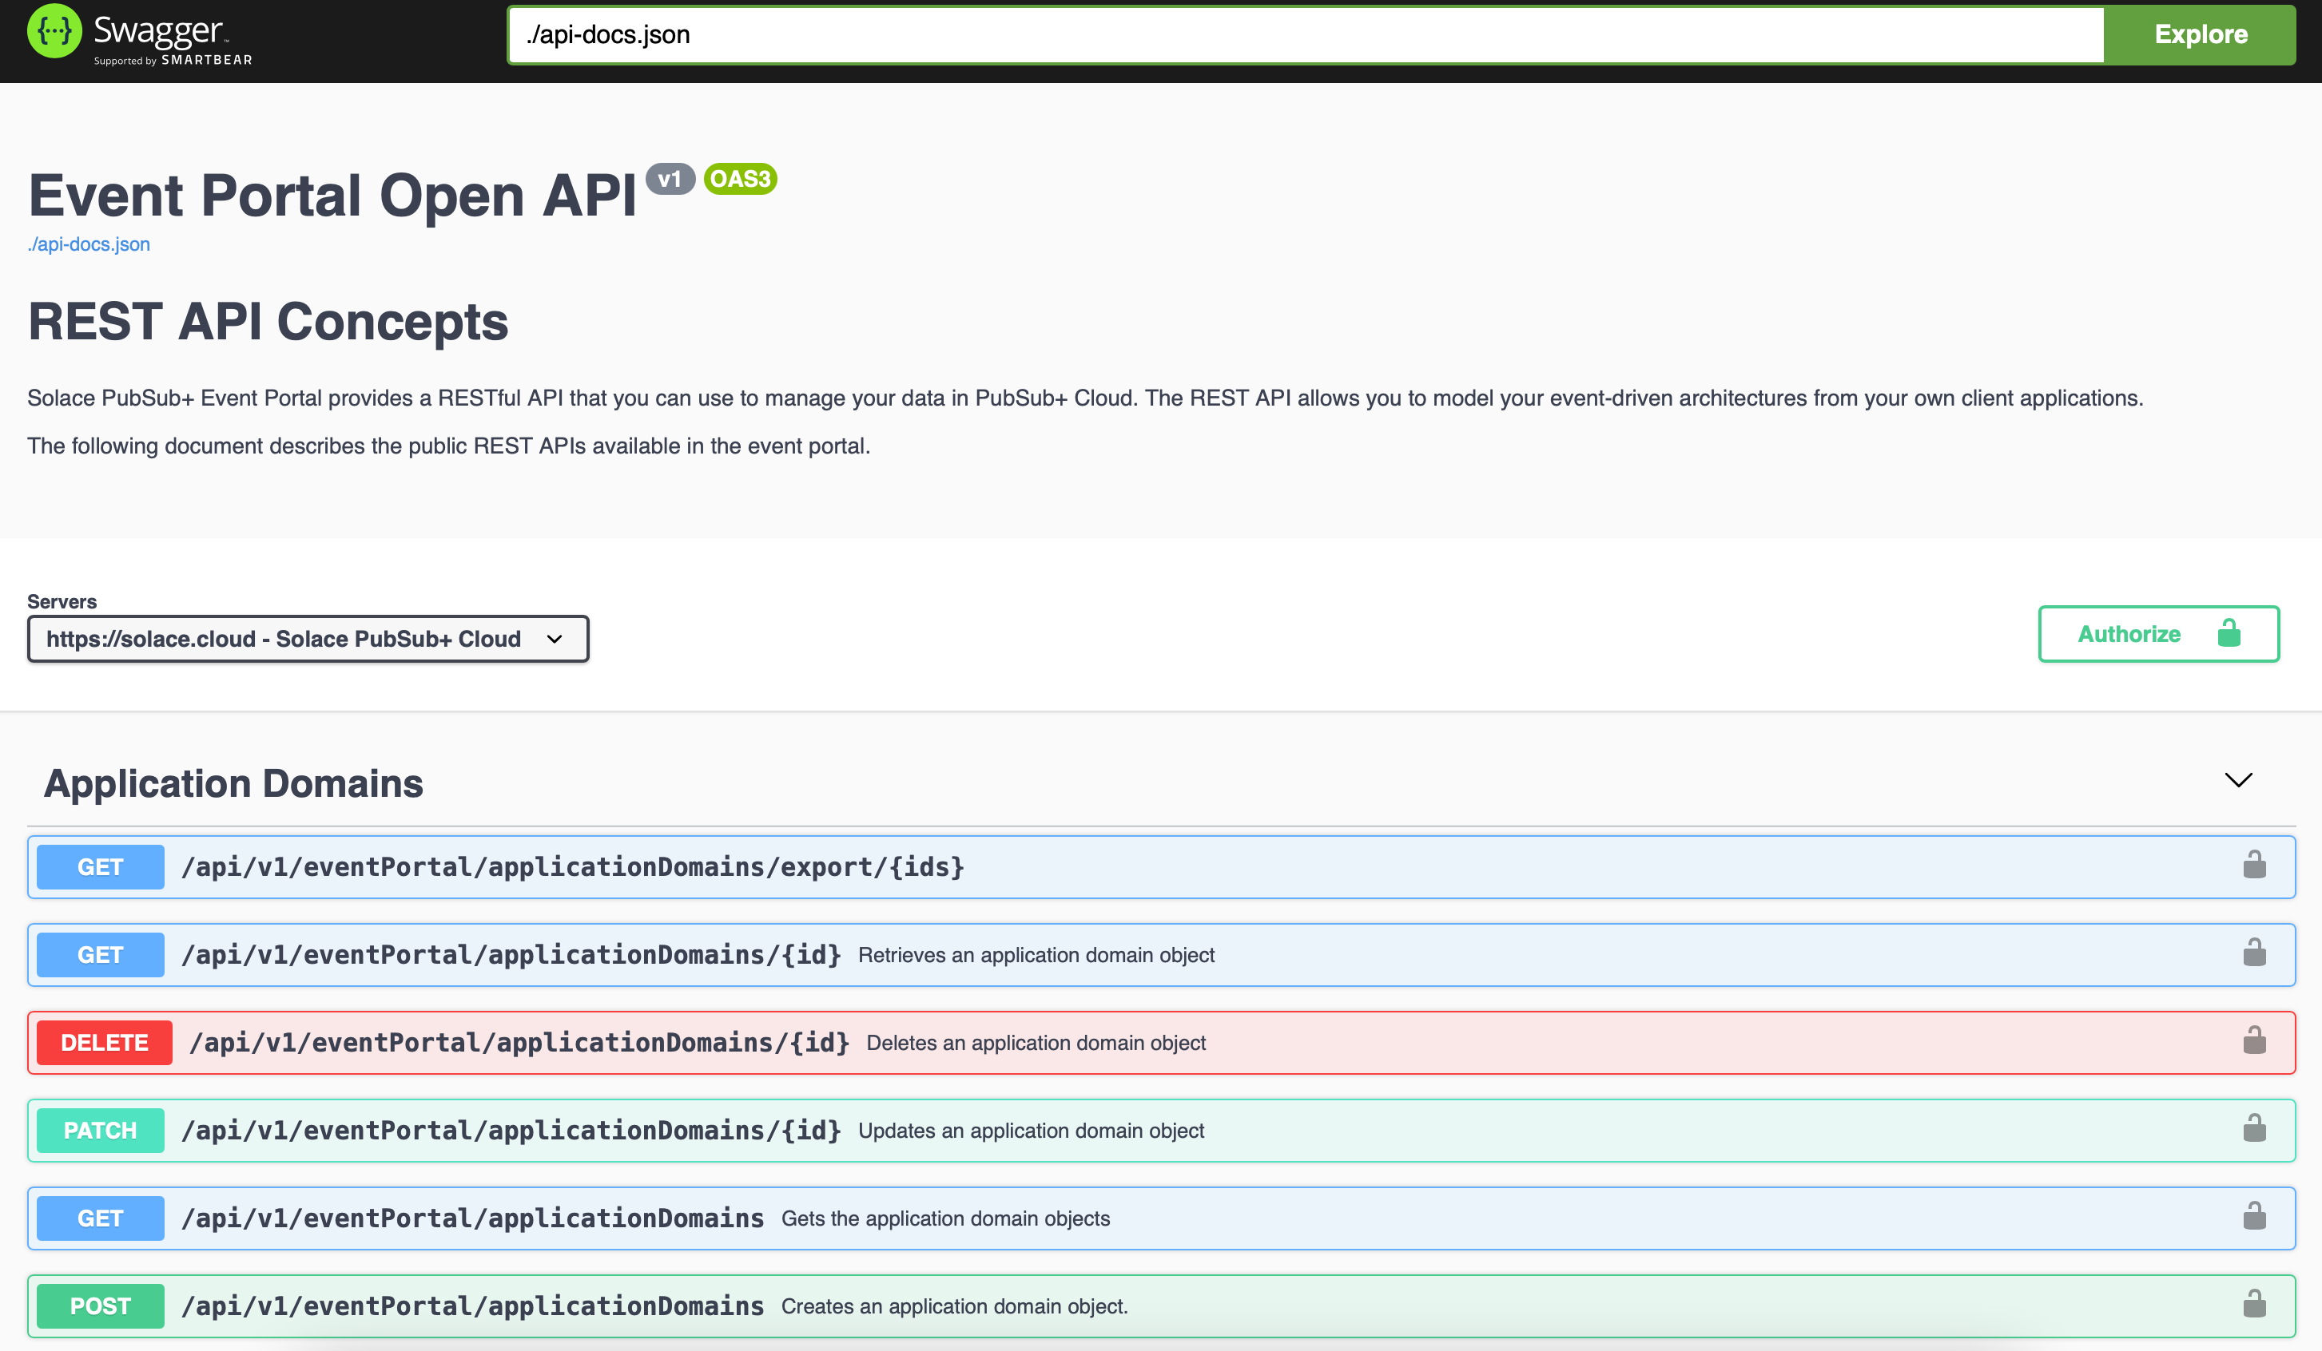
APIs used behind the curtain in this demo
2
Artefact selection
Event Portal REST API
POST queues and topic sub
GET events and apps
SEMP

Slide 8
Thanks for watching Let us know what you think!
tom.fairbairn@solace.com
magali.boulet@solace.com

Slide 9
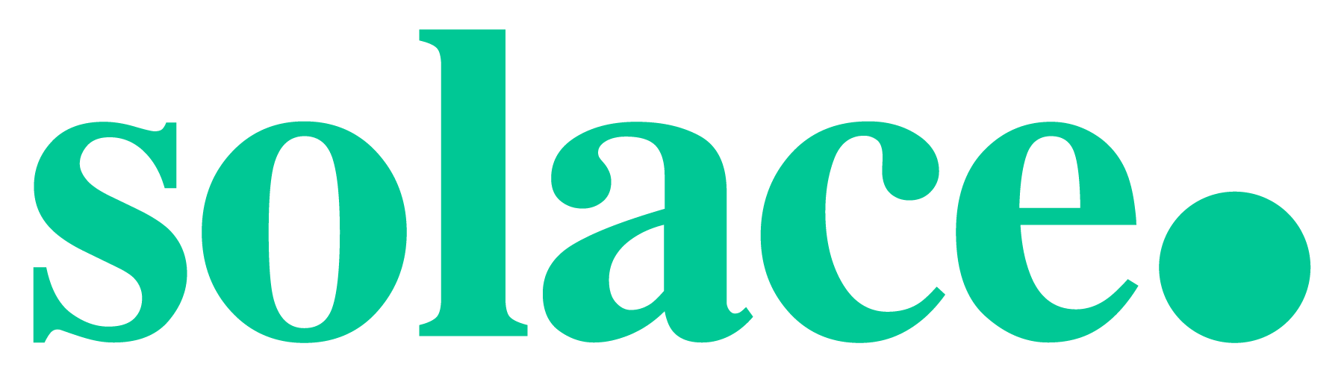
That’s Possible
9

